Slide 1
Automation Interview Preparation

Slide 2
1. About Myself
Name and City
Experience, Company name and Position (Role)
Tools
Project Details
Name
Domain
Modules
Agile
Sprint

Slide 3
2. My Framework
Maven
Selenium
Java
Cucumber
POM
Singleton
Library File
Property File
Driver Folder
Report Folder
GIT
Jenkins

Slide 4
Framework Flowchart Diagram

Slide 5
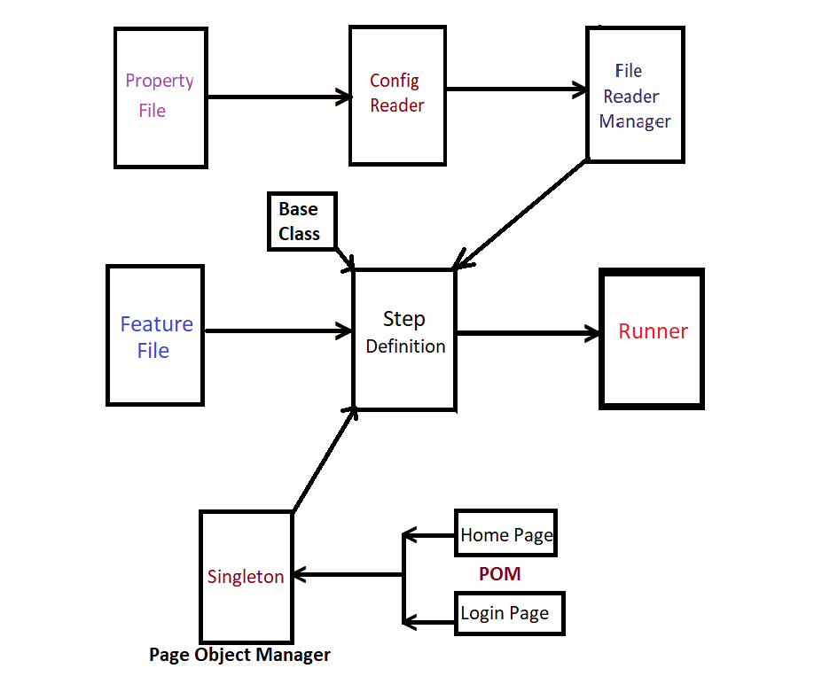
Framework Flow Chart

Slide 6
3. JAVA Questions
Why did you choose java
why java is platform independent?
Constructor
Difference between abstract class and interface
static
final-finally-finalize
throw-throws
for loop
pre-increment & post-increment
while vs Do-while
break vs continue

Slide 7
3. JAVA Questions -2
Array
String - methods
StringBuffer vs StringBuilder
immutable vs muttable
Collection vs Collections
Iterator vs ListIterator
List vs Set
Map
ArrayList vs LinkedList vs Vector
Hashset vs linkedHashSet vs TreeSet
HashMap vs HashTable
Exception Vs Error
Parent of all the classes & interfaces

Slide 8
OOPS
Where did you use all the OOPS concept in your project?
Abstraction
Abstraction - POM - hiding the data
Interface – Web driver
Polymorphism
Method overloading - implicit wait
Method overriding - get(“url”)
Encapsulation
POM - declaring using @Findby and initializing using constructor
Inheritance
In step definition we will inherit Baseclass

Slide 9
Exception
What are the exceptions you have handled in
your project?
WebDriverException
NoSuchElementException
StaleElementException
ArtiyMismatchException
ElementNotVisibleException

Slide 10
4. Programs
Repetitive words
Reverse the String
Triangle
Prime Numbers
Armstrong, Swap, Palindrome, Sorting

Slide 11
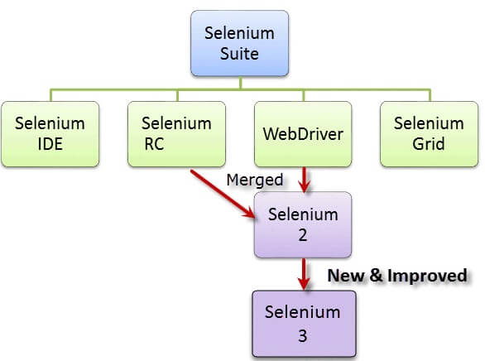
5. Selenium

Slide 12
Selenium IDE
Can use it in Firefox Only.
Can use for simple test cases and test suites

Slide 13
Selenium RC
Also known as Selenium 1,
Allows users to use programming languages in creating complex tests.

Slide 14
Selenium WebDriver,
Automation Framework Tool
It is used to automate web application testing to verify that it works as expected.
supports many browsers such as Chrome, IE, Firefox, Safari
Enables to use a programming language like Java, c#, Groovy, Perl, PHP, Python and Ruby.

Slide 15
Selenium Grid
Running multiple tests across different browsers,
operating systems,
and machines simultaneously
Save time in the execution of your test suites
Uses a hub-node concept
Test:
Running in single machine (hub),
But the execution in different machines (nodes.)

Slide 16
Selenium vs QTP(Quick Test Professional)
Selenium
QTP
Costs and Flexibility:
more Advantageous
It also allows you to run tests in parallel
----
Allows to run tests sequentially.

Slide 17
WebDriver -Advantages
WebDriver is faster than Selenium RC
Because of its simpler architecture.
WebDriver directly talks to the browser
while Selenium RC needs the help of the RC Server.
WebDriver's API is more concise
(brief but Comprehensive) than Selenium RC's.

Slide 18
X-Path
1. Absolute
2. Relative
3. Dynamic

Slide 19
1. Absolute X-Path
It begins with the single forward slash(/) ,
we can select the element from the root node.
Eg: html/body/div[1]/selection/div[1]/h4[1]/b

Slide 20
2. Relative X-Path
Starts from the middle of the HTML DOM structure.
It starts with the double forward slash (//),
It can search the element anywhere at the webpage.
Eg: //*[Class=‘feature-box’]

Slide 21
Dynamic X-Path:
Contains
Or & and
Starts-with
Text
//*[contains(@id, ‘message’)]
//*[@type=‘submit’ or @name=‘reset’]
//label[starts-with@id,’message’]
//td[text()=‘message’]

Slide 22
Xpath Axes Methods
Xpath=//*[@type='submit']//preceding::input[1]
following
Ancestor
Child
Preceding
Following-sibling
Preceding-sibling
Parent
Self
Descendant
(child node ,
//*[@type=‘submit’]//following::input[1]
//*[@type=‘submit’]//ancestor::input[1]
//*[@type=‘submit’]//child::input[1]
//*[@type=‘submit’]//preceding::input[1]
//*[@type=‘submit’]//following-sibling::input[1]
//*[@type=‘submit’]//preceding-sibling::input[1]
//*[@type=‘submit’]//parent::input[1]
//*[@type=‘submit’]//self::input[1]
//*[@type=‘submit’]//descendant::input[1]
grandchild node, etc.)

Slide 23
CSSSelector - Cascading Style Sheet
It is easier to learn/understand
It can do almost everything Xpath can.
Typically faster than Xpath.
It is uses a lot on the development side to style web pages.
we can find or select HTML elements on the basis of their id, class or other attributes
Syntax:
tagName[attributename=attributeValue]
tagName#idattributeValue
tagName.classattributeValue
tagName.classattributeValue1.classattributeValue2
tagName[attributeName$=’endingtextofattributeValue’]

Slide 24
JavaScript Executor:
It is an Interface :
- helps to execute JavaScript through Selenium Web driver.
JavaScript Executor provides 2 methods
- "executescript" & "executeAsyncScript.
In case, the locators do not work,
- We can use it to perform a desired operation on a web element.
If Selenium Web driver fails to click on any element due to some issue,
- We can use it

Slide 25
Robot Class
Robot Class can simulate Keyboard and Mouse Event
Methods
KeyPress()
KeyRelease()
mousePress()
mouseRelease()
mouseMove()

Slide 26
Ajax
AJAX stands for Asynchronous JavaScript & XML,
- Allows the Web page to retrieve small amounts of data from the server without reloading the entire page.
Ajax is a technique used for creating fast and dynamic web pages.
This is asynchronous and uses a combination of Javascript and XML .
It will updates the part/s of a web page without reloading the whole page.
Some of the famous applications that uses AJAX technique
Gmail, Google Maps, Facebook, Youtube, etc.

Slide 27
Alert/Pop up
Simple
Accept()
Prompt
Sendkeys() & accept()
Confirm
Accept() or dismiss();

Slide 28
Wait
Implicit
Certain amount of time
Used for all elements
Explicit
Expected condition or maximum time
Used for Particular element only
Fluent
Condition and Frequency
Definition - Syntax - Difference

Slide 29
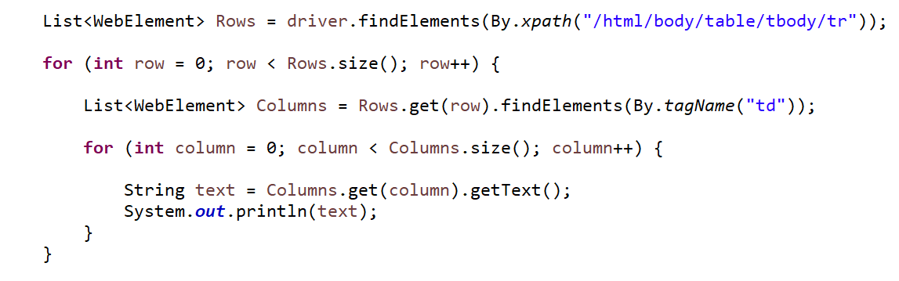
Dynamic Web Table - (Size)

Slide 30
Broken Links:
Broken links are links or URLs that are not reachable.
They may be down or not functioning due to some server error
How to check the Broken Links images:
1. Collect all the links in the web page based on <a> tag.
2. Send HTTP request for the link and read HTTP response code. 3. If response code is >=400, then it is broken based.
4. Repeat this for all the links captured.

Slide 31
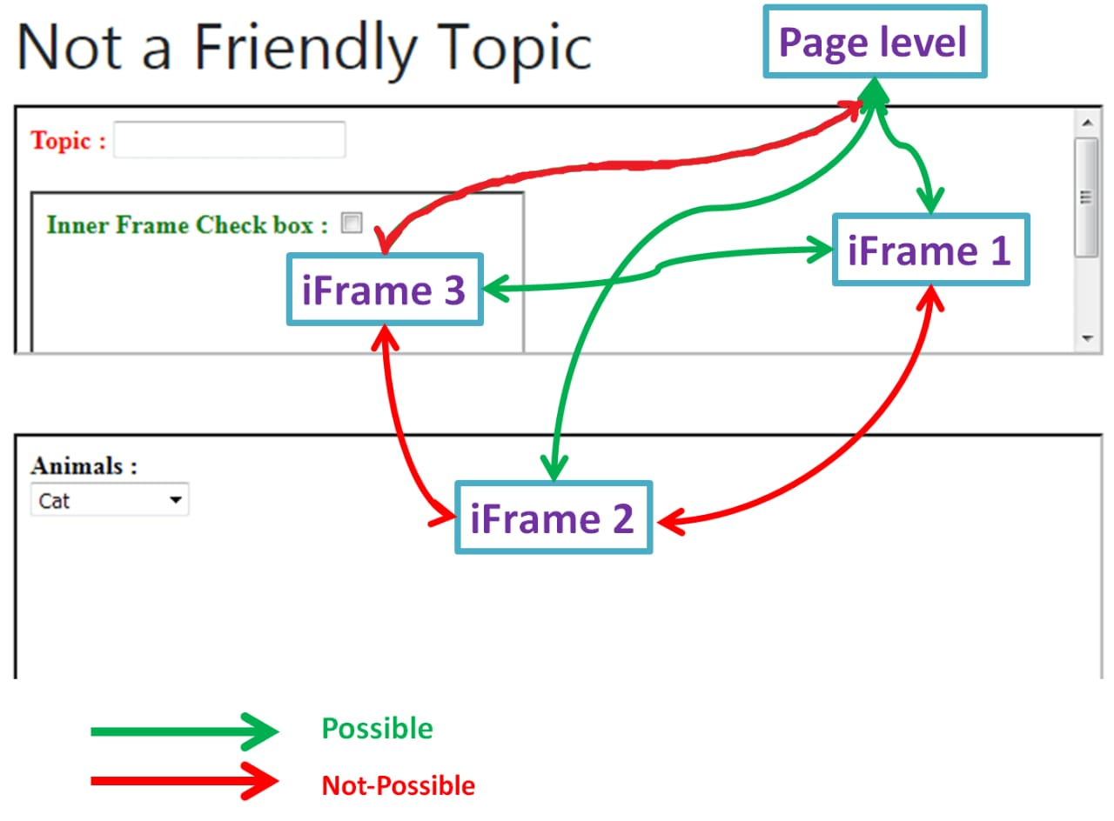
Frames

Slide 32
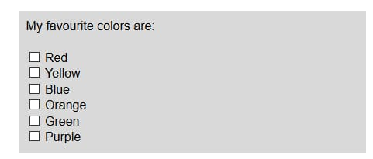
Check Box

Slide 33
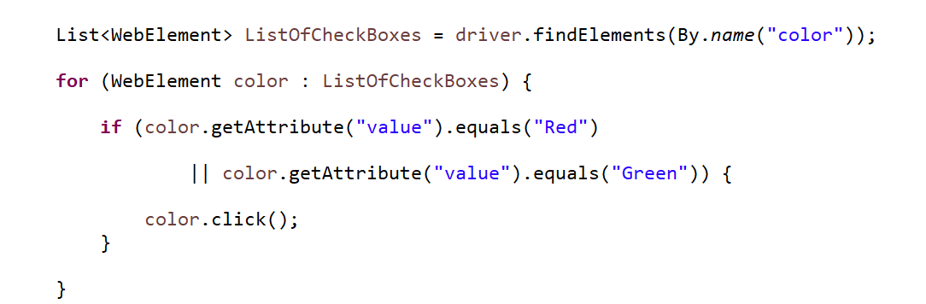
Multiple Check Boxes

Slide 34
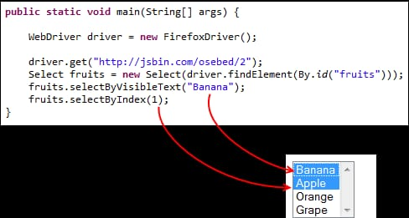
Multiple Drop Down

Slide 35
6. Maven
Maven is a powerful project / build management tool,
Based on the concept of a POM (Project Object Model)
Includes project info and configuration info for Maven
Construction directory, source directory, dependency,
test source directory, Goals, plugins, etc

Slide 36
7. Page Object Model
It is a design pattern to create Object Repository for web UI elements.
Each web page in the application, there should be corresponding page class.
This Page Class - WebElements of that web page
- Page methods - perform operations on those W.E
1. It is an Object Repository design pattern in Selenium WebDriver.
2. POM creates our testing code maintainable, reusable.
3. Page Factory is an optimized way to create object repository in POM concept.

Slide 37
Page Factory (class):
We use annotations @FindBy to find WebElement.
We use initElements method to initialize web elements
Instead of driver.findElements();

Slide 38
8. Singleton Design Pattern
A Class must ensure that single instance should be created
Single Object can be used by all other classes wherever required
Definition:
A class that has only one instance and provides a global point of access to it
How to create?

Slide 39
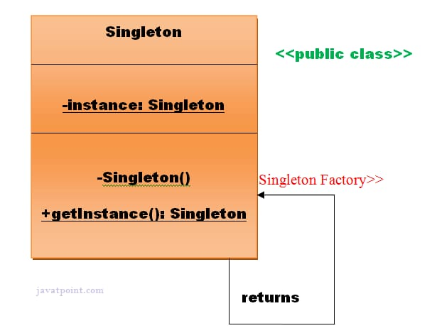
How to create Singleton?

Slide 40
9. JUnit
Assertion
Assert Methods
Eg: Assert.assertEquals(String1, String2);
TestNG Assertion Types
1. Hard Assert
2. Soft Assert (Verify)

Slide 41
10. TestNG
1. Report
2. Grouping
3. Multiple times (Invocation count)
4. Cross browser testing
5. Easily integrated with tools like Maven, Jenkins
6. Failed test cases.
7. Parameters
8. Parallel
9. Data Provider

Slide 42
testng.xml
It captures the entire testing in XML.
This file makes it easy
Define all your test suite
Their parameters in one file, which you can verify in your code repository or e-mail to co-workers.
It also makes it easy
To pull out subsets of your tests or split several runtime configurations.

Slide 43
Cross-Browser Testing
Web-based applications are totally different from Windows applications.
A web application can be opened in any browser by the end user.
Reason Cross Browser Issues.
Font size mismatch in different browsers.
JavaScript implementation can be different.
CSS,HTML validation difference can be there.
Some browser still not supporting HTML5.
Page alignment and div size.
Image orientation.
Browser incompatibility with OS. etc

Slide 44
11. Cucumber (BDD)
Runner
RunWith
Cucumber.class
CucumberOptions
Feature
Gherkin Language
StepDefinition
Extends BaseClass
English Scripts → Selenium-Java Actions

Slide 45
12. GIT
Distributed Version Control System
How to connect?
How to push?
How to pull?

Slide 46
13. Jenkins
CICD Tool
Terms
Job
Project
Workspace
Build
Configure

Slide 47
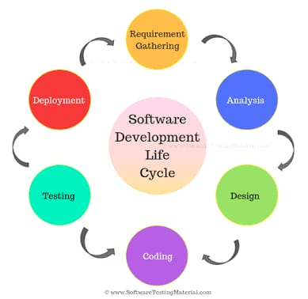
14. SDLC Software Development Life Cycle

Slide 48
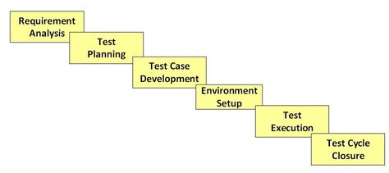
15. STLC Software Testing Life Cycle

Slide 49
Phase 1: Requirement Analysis
Test Team studies the requirements to identify the testable requirements
QA team interact with Client, BA, Tech Leads, System architects
To understand the requirements in detail
Deliverables
RTM
Automation Feasibility Report

Slide 50
Phase 2: Test Planning
Senior QA Manager determines Effort & Cost estimates
Preparation of Test Plan Document for various types of testing
Tool selection
Resource planning and determining R&R
Training Requirements
Deliverables:
Test Plan Document
Effort Estimation Document

Slide 51
Phase 3: Test Case Development
Create test Cases, Automation Scripts
Review and Verify test cases & test scripts
Create Test Data
Deliverables
Test Cases/Scripts
Test Data

Slide 52
Phase 4: Environment Setup
Understand required architecture, environment set-up
Prepare H/W , S/W requirement list
Setup Test Environment and test data
Perform Smoke Test on the build to do a readiness check of the given environment
Deliverables
Environment Ready with Test Data Setup
Smoke Test Results

Slide 53
Phase 5: Test Execution
Execute tests as per Plan
Document test results and log defects for failed cases
Bugs will be reported to dev team for correction
Retest the Defect fixes
Track the defects to closure
Deliverables
Test Cases – Updated Result
Defect Reports

Slide 54
Phase 6: Test Cycle Closure
Prepare Test closure report
Evaluate cycle completion criteria
Prepare test metrices.
Test Result analysis
Deliverables
Test Closure Report

Slide 55
16. JIRA
Defect Tracking Tool
To create a issue,
Project : Name of the Project
Issue Type : Bug/Epic/Story/Task/Subtask/New Feature
Summary : One line summary
Description : Details of the issue
Priority : High/Medium/Low/Lowest
Labels : Specific type of issue
Issue(Related To) : User can link the Issue ID to the linked issue
Assignee : Who is responsible to fix this issue.
Epic Link : If the issue belongs to any of those Epic Link
Sprint : In which Sprint, this issue addressed

Slide 56
17. Other Frameworks
There are mainly three type of frameworks created by Selenium WebDriver to automate manual test cases
Data Driven Test Framework - (Excel)
We will have our test data here only
Keyword Driven Test Framework
keywords are written in some external files like excel file
Java code will call this file and execute test cases.
Hybrid Test Framework
Mix of keyword driven and data driven framework

Slide 57
18. JDBC
JDBC (Java Database Connectivity) is a SQL level API
that allows us to execute SQL statements.
It is responsible for the connectivity between the
Java Programming language & a wide range of databases.

Slide 58
JDBC Steps:
1) create a connection to the Database
DriverManager.getConnection(URL, "userid", "password" )
2) load the JDBC Driver
Class.forName("com.mysql.jdbc.Driver");
3) can use the Statement Object to send queries
Statement st = con.createStatement();
4) execute the SQL queries
ResultSet rs = st.executeQuery(select * from employee;);

Slide 59
19. Agile
Meetings
Sprint Grooming/Planning meeting
Sprint Demo meeting
Sprint Retrospective meeting
Daily Scrum Call @ 9.00 AM
Participants – Client, Lead, Dev Team, Automation Team

Slide 60
Sprint
2 weeks of sprint
1.5 years – 35 sprint
Last Sprint 35
Current Status:

Slide 61
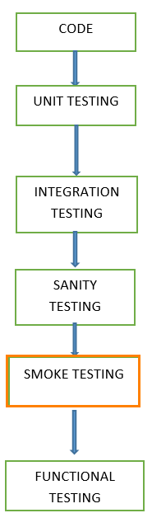
20. Manual Testing
Flow of
Different kinds of Testing

Slide 62
Regression Testing
To confirm that a recent program or new code change
has not adversely affected existing features

Slide 63
When Regression Testing?
After the changes in requirements and code modified according to the requirement
After new feature added to the software
After defect fixed
After performance issue fixed
After alterations to an application's hosting environment.

Slide 64
Smoke Testing
To confirm that the critical functionalities of the program
are working fine after software build

Slide 65
When Smoke Testing?
"before" any detailed functional or regression tests are executed on the software build.
To decide if a build is stable enough to proceed with further testing
Why?
- If the build is imperfect/defective, further testing would be waste of time and resources.
- To detect early major issues.

Slide 66
Sanity Testing?
To check the new functionality/bugs have been fixed.

Slide 67
Smoke vs Sanity
Smoke Test
It is like General Health Check Up
Sanity Test
It is like specialized health check up

Slide 68
Black Box Testing
This is a testing technique in which functionality of the
Application Under Test (AUT) is tested
without looking at the internal code structure,
implementation details and
knowledge of internal paths of the software.
This type of testing is based entirely on
software requirements and specifications.

Slide 69
White box testing
Testing software’s internal structure, design, and coding.
In this type of testing, the code is visible to the tester.
It focuses primarily on verifying
the flow of inputs & outputs through the application,
improving design and usability,
strengthening security.

Slide 70
UAT – User Acceptance Testing
Testing a software by the user or client
to determine whether it can be accepted or not.
This is the final testing performed
once the functional, system & regression testing
are completed

Slide 71
Important Interview Questions

Slide 72
1. What are the challenges you
faced in your project?

Slide 73
1. Pop-up Windows
In many application, random pop-up keeps coming
and their behavior is not persistence
these unwanted pop up which stops our execution.
And, Windows-based alerts are beyond Selenium’s capabilities
since they’re part of the operating system instead of the browser.
However, since Selenium WebDriver can operate multiple windows,
Web-based alerts can usually be handled
with the switch To method to control the pop-up
while keeping the browser in the background.

Slide 74
2. Dynamic Content
A web page that has dynamically loaded content has elements that may not be at first visible when you visit the site.
Page is user specific and will display different content
- based on different users,
- new content appears on page after certain amount of time,
- it appears after clicking something on the page.
when a locator cannot identify a new element present at that time,
Selenium WebDriver comes with an integrated Explicit Wait
before automating a command.
This helps the page to have enough time to load and identify the element to interact with.

Slide 75
3. Timeout issue
It is one of the most challenging tasks in any test automation tool.
If we do not handle this, then most of the script will fail.
Survey: 80% of scripts fail due to improper sync/timeout.
We can avoid this by using smart wait like
implicit wait, explicit wait, fluent wait or
we can write our custom method which will handle this.
Example- After clicking on some button one alert should present and we have handled via code but due to many issues alert might come after few seconds in that case script will fail.

Slide 76
4. Integration with different tools
Since Selenium is an open source and
we are using other many open sources
like Maven, Jenkins, AutoIT etc.
So Integration between all tools is sometimes
a very challenging task

Slide 77
5. Smart locators
As locators are the core part of any scripting and
We need to keep on enhancing our XPath and CSS
for script stability
because if XPath and CSS are not proper,
then it fails in upcoming releases.
We should always write dynamic or custom XPath
which can make our script more stable.

Slide 78
6. Cross browser testing
We always focus Test designing on one browser
But in real execution of the script ,
we have to make sure that our script should run in all browser
which is known as Cross Browser Testing (Chrome, FF, IE at least).
Few locators will work in one browser but not on the other.
If script is failing on another browser, we need to change locator strategy.

Slide 79
7. Framework enhancement
We always work for the framework
but framework designing and maintenance
is not a one-day activity
we have to keep on adding new features or library
so that we can minimize execution time and maintenance task

Slide 80
Non-Automatable
Captcha
Bar code
Image / Video Previews
Payment gateway timeouts
Gestures

Slide 81
2. How do you handle window based pop up?

Slide 82
AutoIT
Selenium is an open source tool that is designed
To automate web-based applications on different browsers
But to handle window GUI and non HTML popups in application.
AutoIT is required as these window based activity
are not handled by Selenium.
There is two components.
AutoIT editor & element identifier

Slide 83
How will you run your test scripts if it is taking long time to complete?

Slide 84
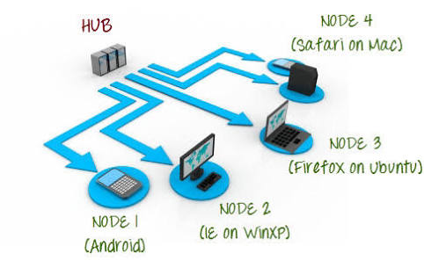
Selenium Grid

Slide 85
Selenium Grid
Run the tests against different browsers, OS and Machines all at the same time.
Save time in the execution of your test suites
Hub – Node Concept
DesiredCapabilities
RemoteWebDriver

Slide 86
REST API
Application Programming Interface
It allows software applications to communicate with each other via API Calls
REST – Representational State Transfer
Ex: Google search, Weather Report.
4 Methods
GET – Extract data
POST – Create new
PUT - Update existing one
DELETE – Removes all current representations

Slide 87
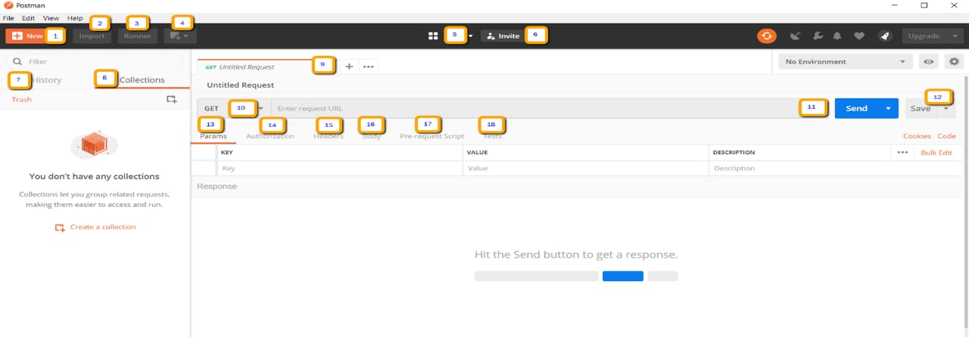
Postman

Slide 88
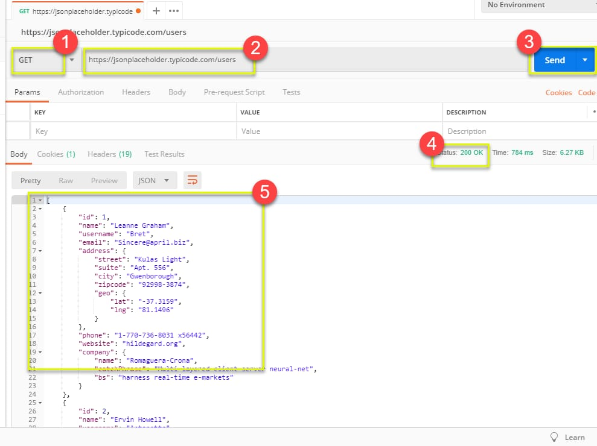
Postman
Popular API Tool

Slide 89
SQL
Keywords
S ELECT
UPDATE
DELETE
INSERT INTO
CREATE DATABASE
ALTER DATABASE
CREATE TABLE
ALTER TABLE
DROP TABLE
Constraints - 7
Not Null
Unique
Primary Key
Foreign Key
Check
Default
Index

Slide 90
Important Examples
SELECT Count (*) AS DistinctCountries FROM (SELECT DISTINCT Country FROM customers);
SELECT * FROM Customers WHERE NOT Country=‘India’ AND Country=‘USA’;
SELECT Name, Id FROM Customers ORDER BY Country ASC, CustomerName DESC;
SELECT * FROM Customers WHERE ROWNUM<=3;
SELECT MIN(Price) As SmallestPrice FROM Products; -- AVG(), SUM(), COUNT();
SELECT * FROM Customers WHERE Name LIKE ‘%a’; -- BETWEEN value1 AND value2

Slide 91
Join
Join is Clause is used to combine rows from two or more tables, based on a related column between them.
Different Types of SQL JOINs:
(INNER) JOIN: Returns records that have matching values in both tables
LEFT (OUTER) JOIN: Returns all records from the left table, and the matched records from the right table
RIGHT (OUTER) JOIN: Returns all records from the right table, and the matched records from the left table
FULL (OUTER) JOIN: Returns all records when there is a match in either left or right table

Slide 92
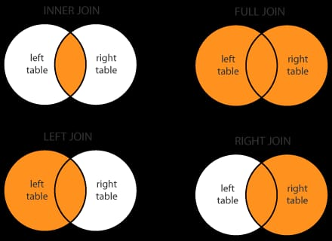

Slide 93
How many test cases you can do per day?
This is completely based on Validation
Number of test cases would be increased
as few as number of validation is less.
Validation Number of TestCases
10 1 or 2
5 5
1 0r 2 7 to 9

Slide 94
3. About my Project?
Which Domain?
Tools Used
What are the Modules you have done?
Can you write Test Cases?

Slide 95
4. About my company.
Location
Going by Bus/Cab?
Near landmark/ IT Companies
How many employees?
Permanent/Contract based?
Product based/Service based?
Client Location ?

Slide 96
Package:
Gross Salary -
Net Salary -
Variable Pay -
Last Promotion Date -
Last Salary Revision Date -
PF -
3 Month PaySlip/Bank Statement/Form 16
All other Documents -
Supervisor Name -

Slide 97
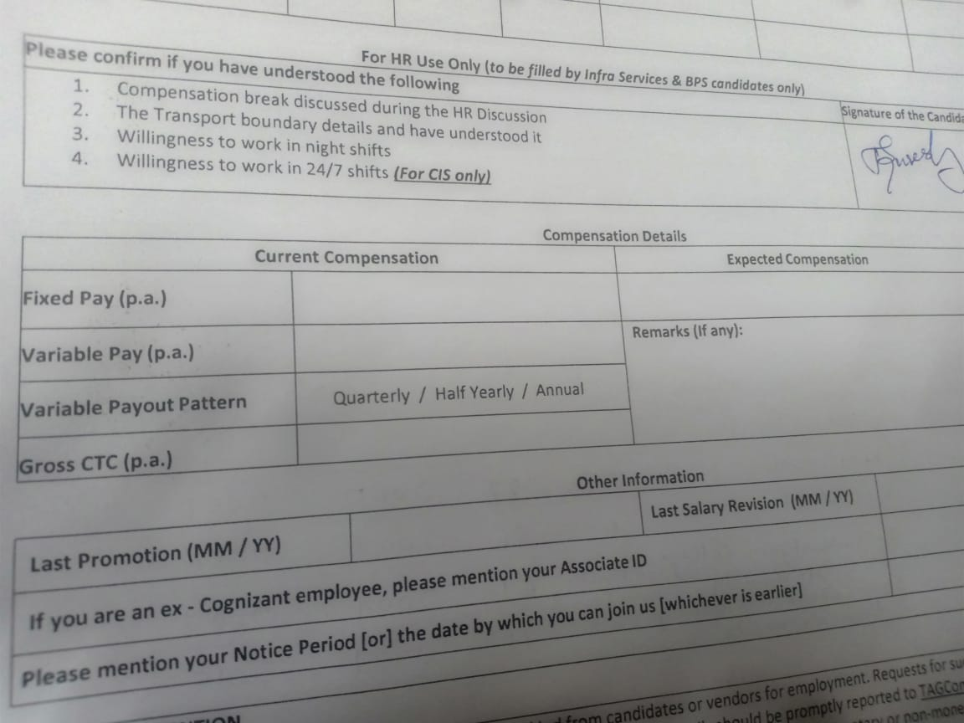

Slide 98
Preparing ourself
It’s not first interview for 4 years experienced candidate
Keep Smiling, till the end
No fear and hesitation
Be confident and positive
He is not a Boss or Senior
Don’t think Interviewer is technically strong
He is just your team-mate.
Casual/Spontaneous/Spot answer and no prepared answer
Have confidence in your answers.
If any argument happens, show your learning attitude.
Keep this is in mind : I am going to get 4 offer letter

Slide 99
Thank you

Slide 100
All the Best

